Slide 1
Safety Event Reporting in the Ambulatory Setting:
A Story of Success
Beverly Loudin, MD, MPH
Ailish Wilkie, MS, CPHQ

Slide 2
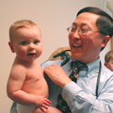
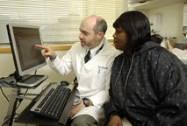
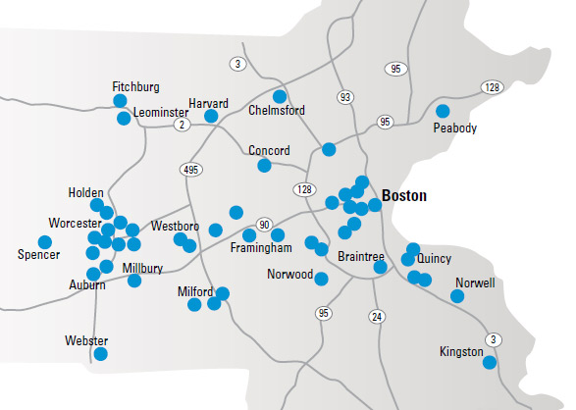
Atrius Health- Who we Are
Non-profit alliance of six leading independent medical groups and VNA network
  Granite Medical
  Dedham Medical Associates
  Harvard Vanguard Medical Associates
  Reliant Medical Group
  Southboro Medical Group
  South Shore Medical Center
  VNA Care Network and Hospice
Providing care for ~ 1,000,000 adult and pediatric patients
1096 Physicians
1450 other healthcare professionals across 35 specialties
7483 Employees
3.8 Million Ambulatory Visits Per Year
VNA Care Network covering Eastern and Central Mass with 750 employees

Slide 3

It’s a Journey, not a Destination!
2008: The Department of Patient Safety & Risk Management is created and consists of a Director and a Senior Project Manager
2009: An electronic reporting system (SERS) is implemented and there is an immediate increase in reporting
2010: The Director leaves; now a department of one!
2011: A Medical Director is hired in early 2011
2011(late)/2012: Three Patient Safety and Risk Management specialists and a systems administrator are hired

Slide 4
It’s a Journey!
System Interventions:
  Simplified WebForm used to enter events in SERS
    Reduced from 7 pages to 1
    Constrained pick lists for ease of use and less scrolling
  Incorporated additional reporting mechanisms
    Staff messaging within the EMR
    Direct phone line to Patient Safety & Risk Management

Slide 5
It’s a Journey!
Staff Interventions:
  Specialists assigned to individual groups and sites to:
    Work directly with site and group leaders on patient safety initiatives
    Sit on local safety committees
    Provide education and training at the local level
  Feedback to reporters
    Email to all reporters when event is closed in the system - has limitations
    Developed monthly email for reporters during that month to highlight lessons learned
    Developed monthly Safety Champion initiative to celebrate individual contributors
    Email to all clinician reporters when their events are closed with detail of outcome
    Developed patient safety dashboards for each Atrius Group and Harvard Vanguard site

Slide 6
It’s a Journey!
Leadership Interventions:
  Development of Atrius-wide Hoshin Metrics
    2010 – Report an event on .25% of patient encounters
    2011 – Increase the number of unique reporters
    2012 – Increase the number of unique reporters
    2013- Event closure within 30 Days

Slide 7
Lessons Learned
  Change doesn’t happen overnight
  You can’t train everyone!
  Find the balance between quality and quantity
  The more visible we are the greater the result

Slide 8

Data doesn’t lie, reporting has increased 213%!
SERS Implemented

Slide 9
Continuing the Journey…
  Culture of Safety Survey – Fall 2013
  Upgrade rL Solutions software- Fall 2013
  Provide training to event reviewers on systems thinking

